Slide 1
Rectifiers, Filters and Regulator
Marks 16
Visit for more Learning Resources

Slide 2
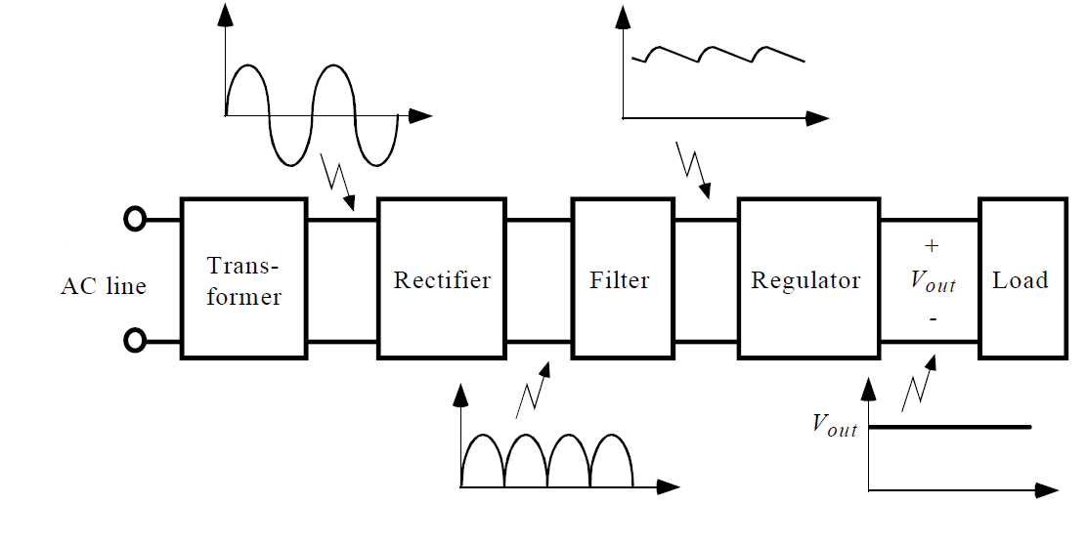
Basic Block Diagram of Regulated power Supply

Slide 3
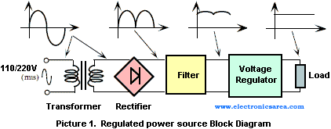

Slide 4
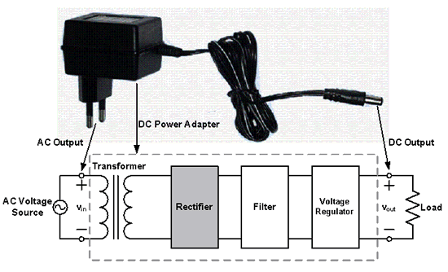

Slide 5
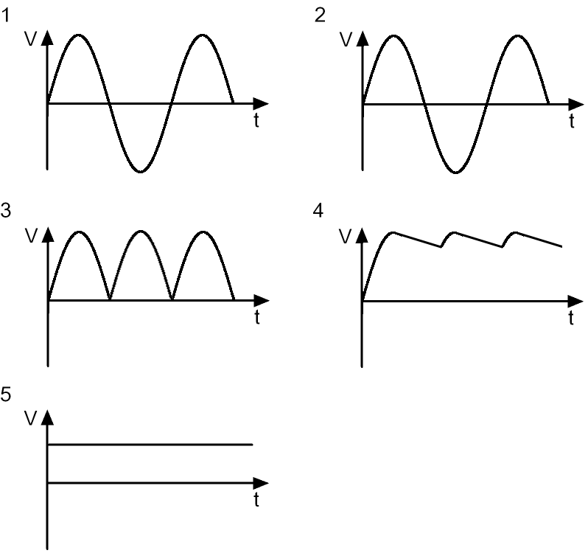
Wave forms at various points in a Regulated power supply

Slide 6
Rectification
Rectification is a process of converting the alternating quantity (voltage or current) into a corresponding direct quantity(voltage or current).
The input to a rectifier is AC whereas its output is unidirectional or DC.

Slide 7
Rectifiers
Rectifier is an electronic device which is used for converting an alternating quantity (Voltage or current) into unidirectional i.e. DC quantity (Voltage or current).
Block diagram of Rectifier:

Slide 8
Need of Rectification
Every electronic circuit such as amplifiers, needs a DC power source for its operation.
This DC voltage has to be obtained from AC supply.
For this the AC supply has to be reduced () Stepped down first using a Step down transformer and then converted to dc by using rectifier.

Slide 9
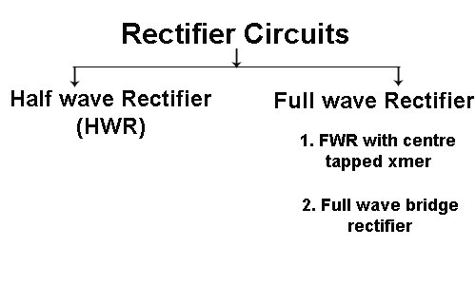
Types of Rectifier

Slide 10
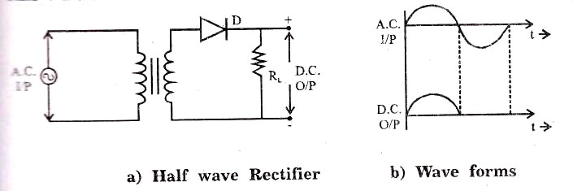
Half Wave Rectifier

Slide 11
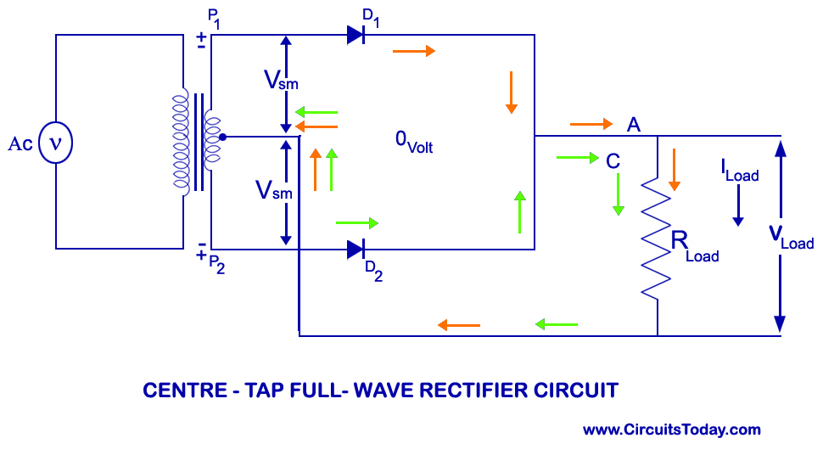
Full Wave Rectifier (Center Tapped Transformer)

Slide 12
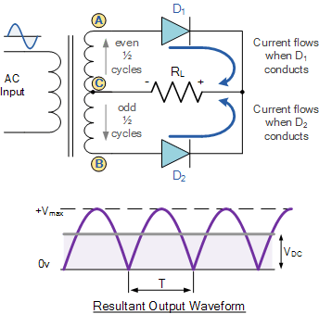

Slide 13
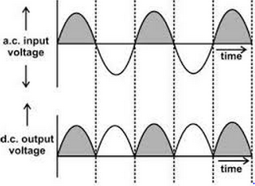

Slide 14
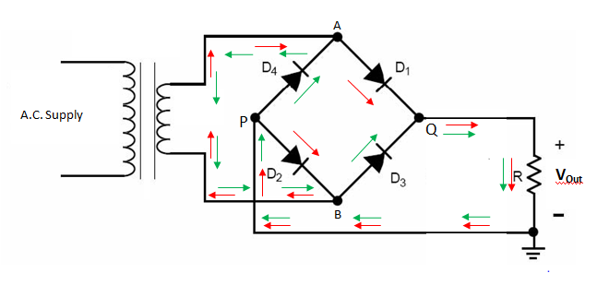
Full Wave Rectifier (Bridge)

Slide 15
For more detail contact us

